Slide 1


Digital Image Filters
Mikołaj Leszczuk, Zbigniew Hulicki, Jakub Nawała
Faculty of Computer Science, Electronics and Telecommunications Department of Telecommunications 04/11/2020
www.agh.edu.pl

Slide 2
Digital Image Filters
Image filtering – a process in which a number, quantity etc., of image pixels is altered or manipulated according to formal (i.e. mathematical) rules/ operations and result in a new, modified image
Image filtering is called as the context transformation because to get/compute a new pixel value in the modified image it does require an information from a numer of pixels in the source image

Slide 3
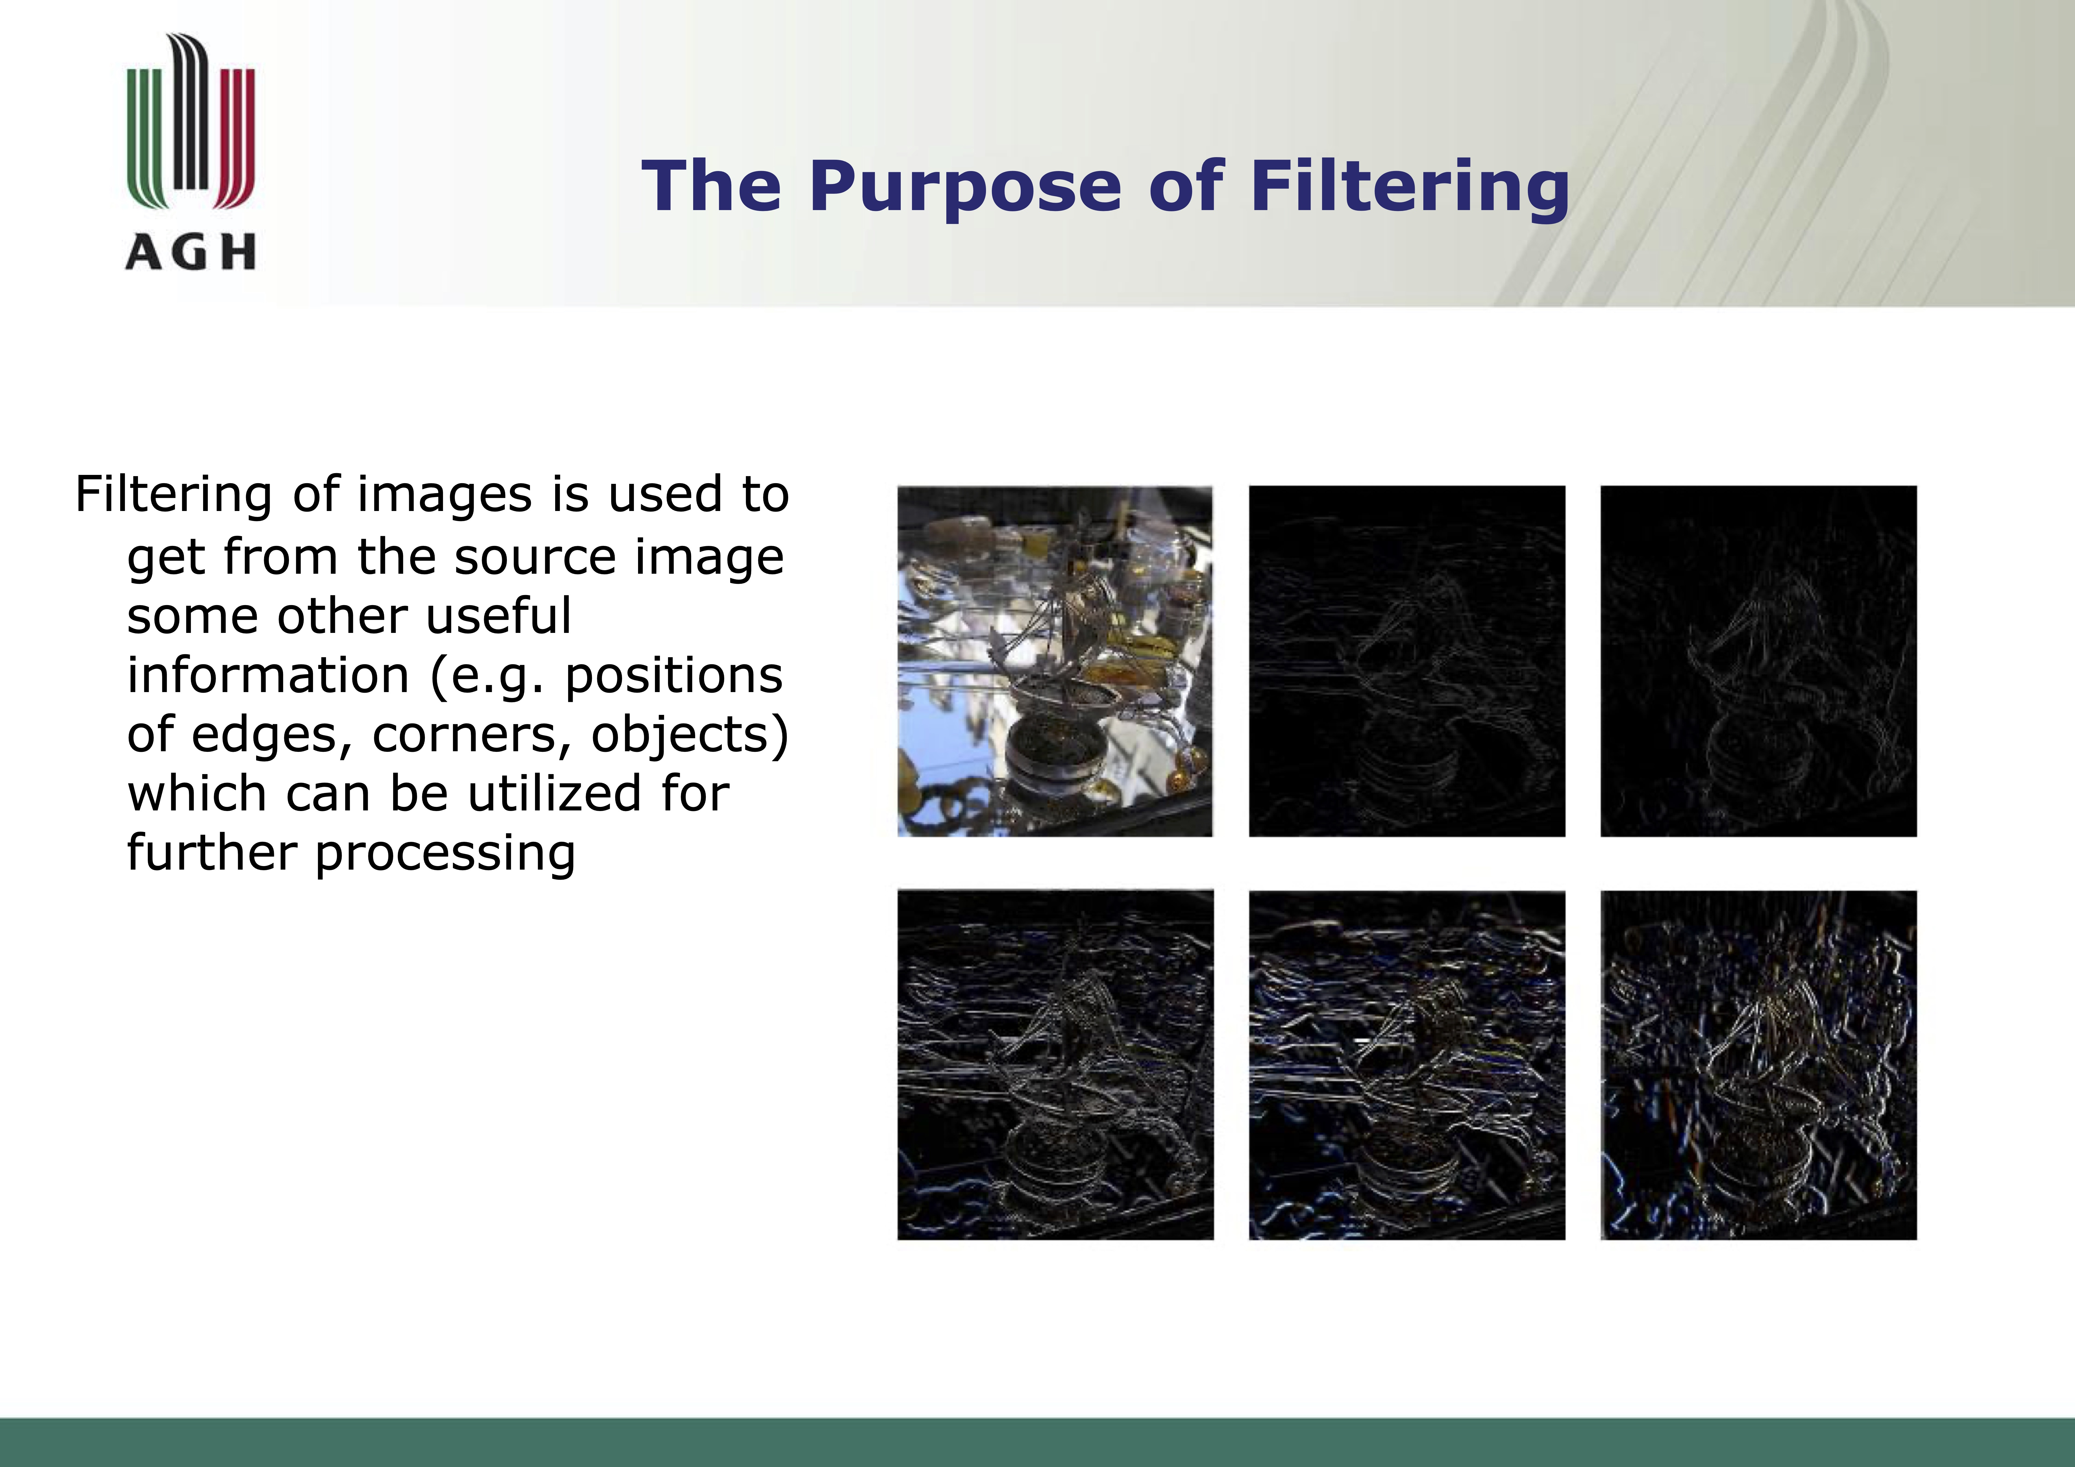

Slide 4
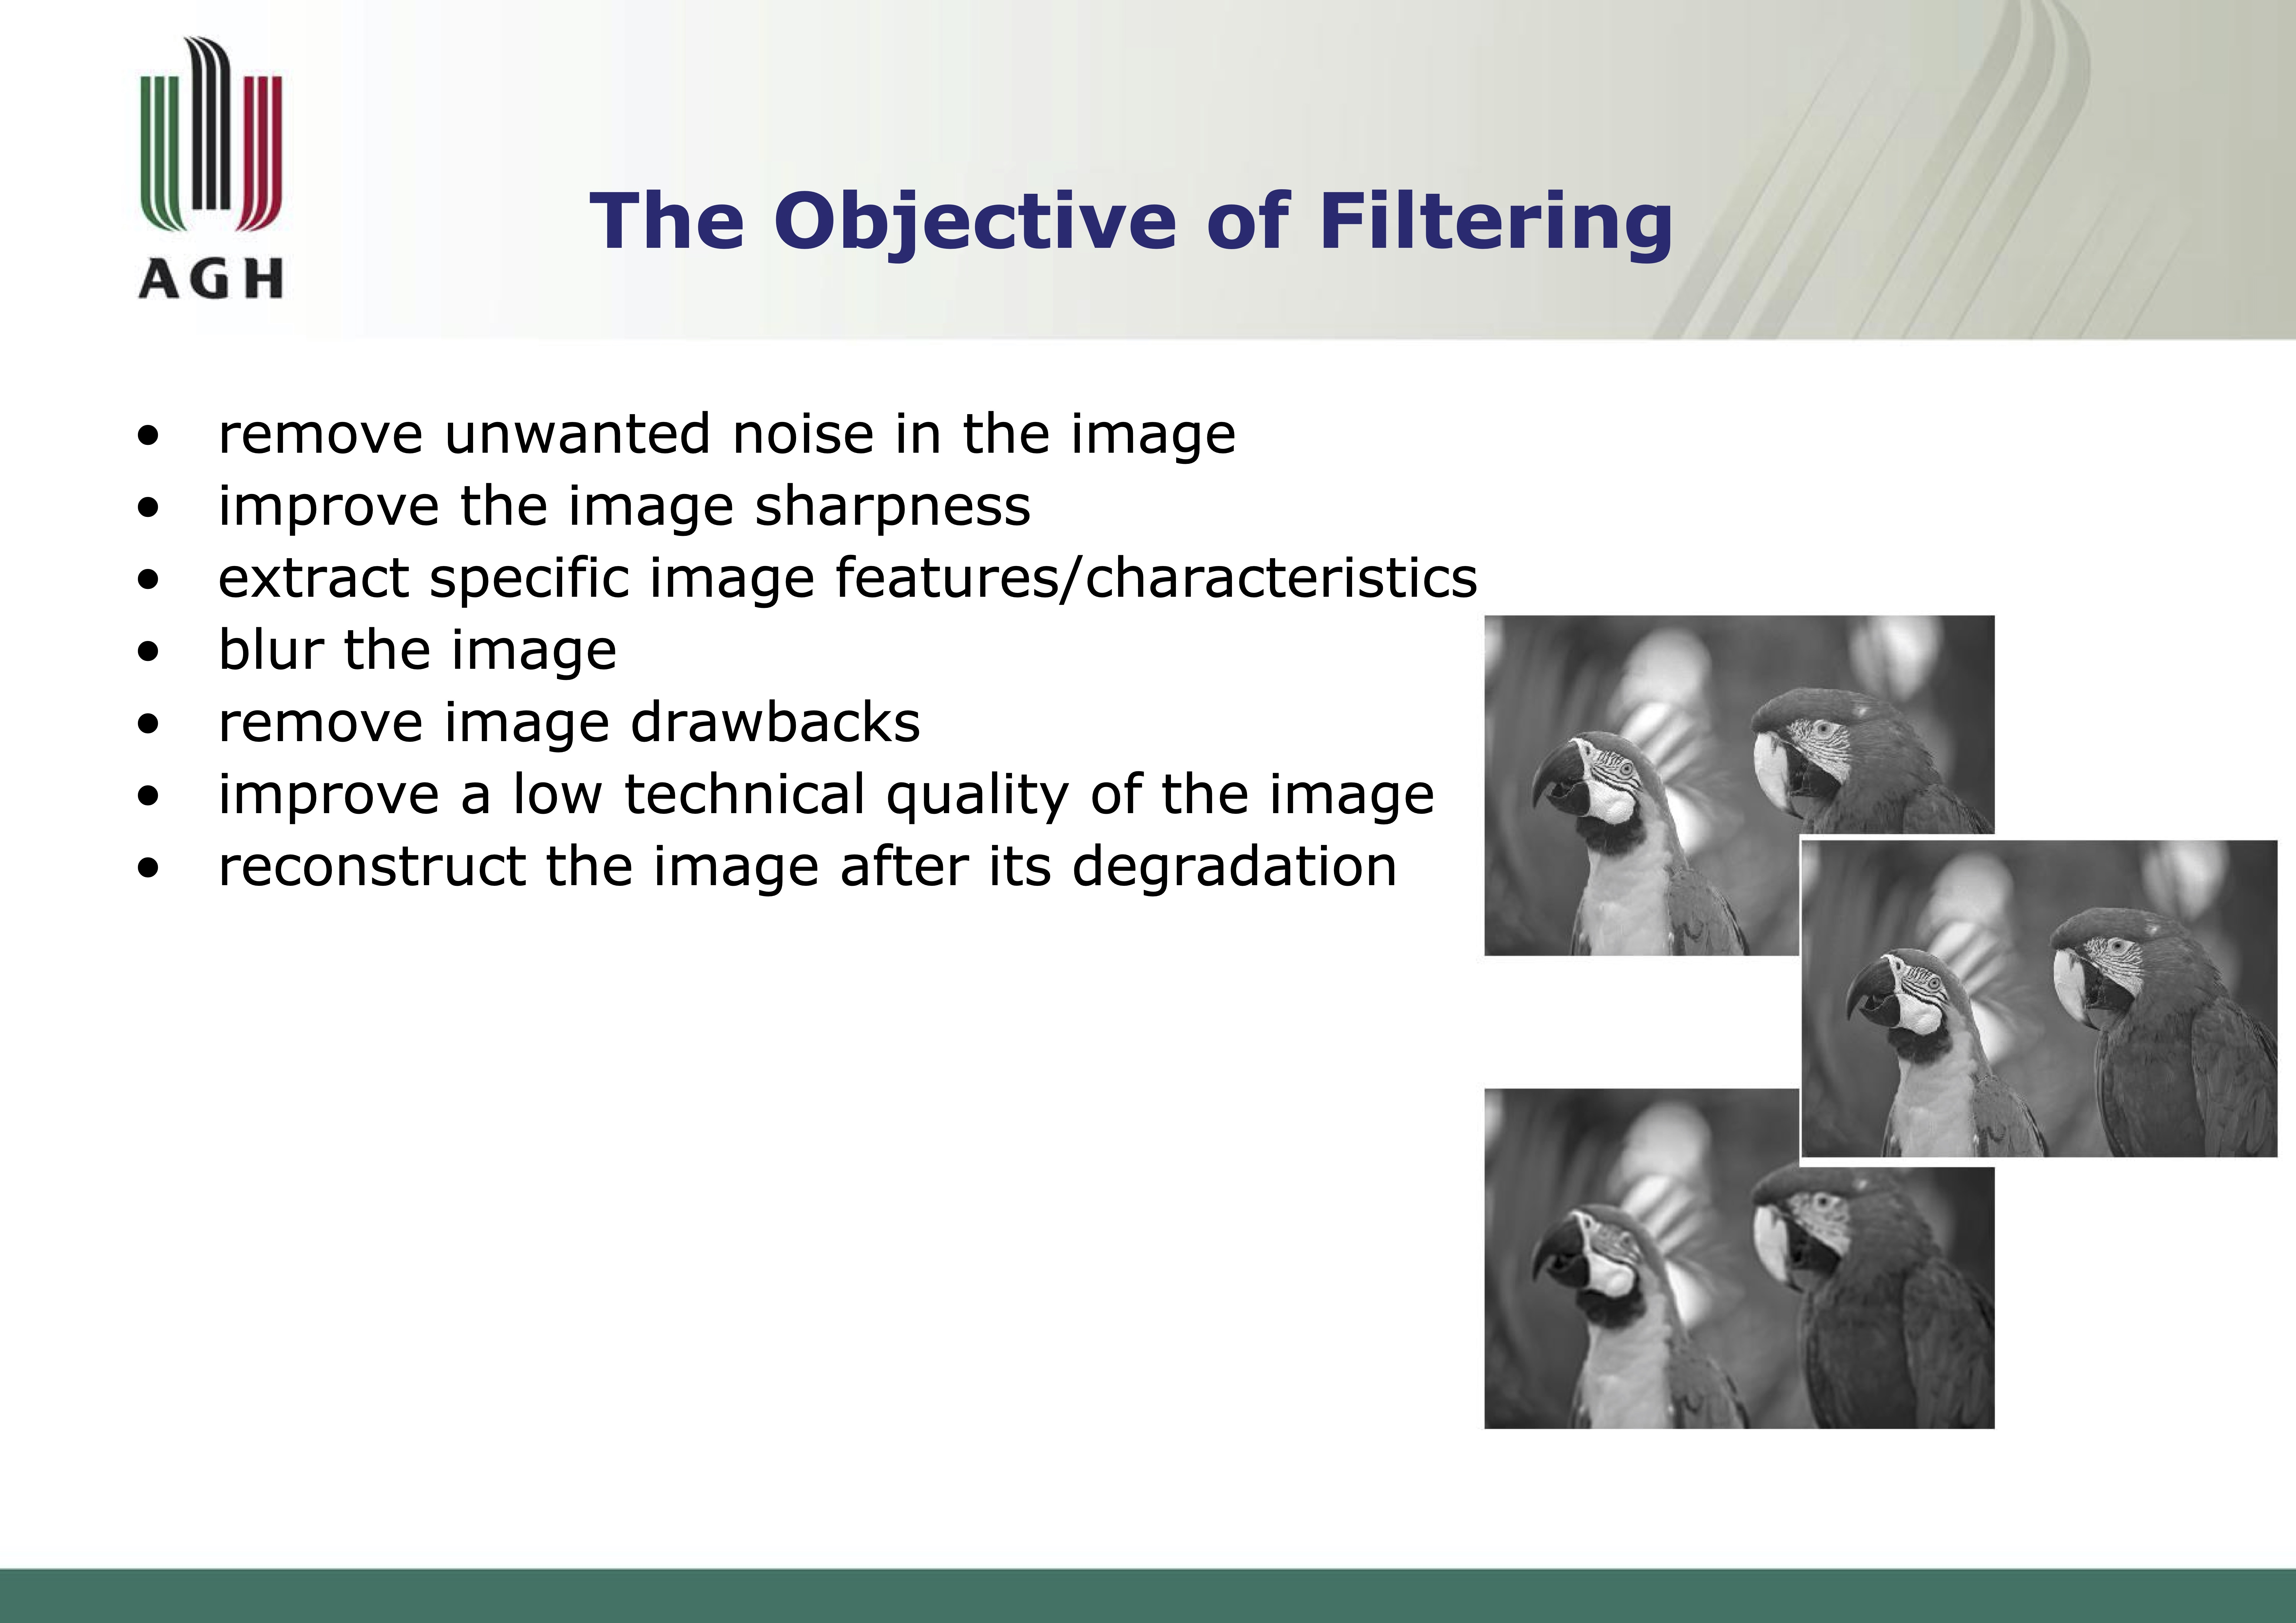

Slide 5
Digital Image Filters as Part of the Pre-Processing for Artificial Intelligence
Before a computer vision method can be applied to image data in order to extract some specific piece of information, it is usually necessary to process the data in order to assure that it satisfies certain assumptions implied by the method
Examples are:
Digital image filters
Re-sampling to assure that the image coordinate system is correct
Noise reduction to assure that sensor noise does not introduce false information
Contrast enhancement to assure that relevant information can be detected
Scale space representation to enhance image structures at locally appropriate scales

Slide 6
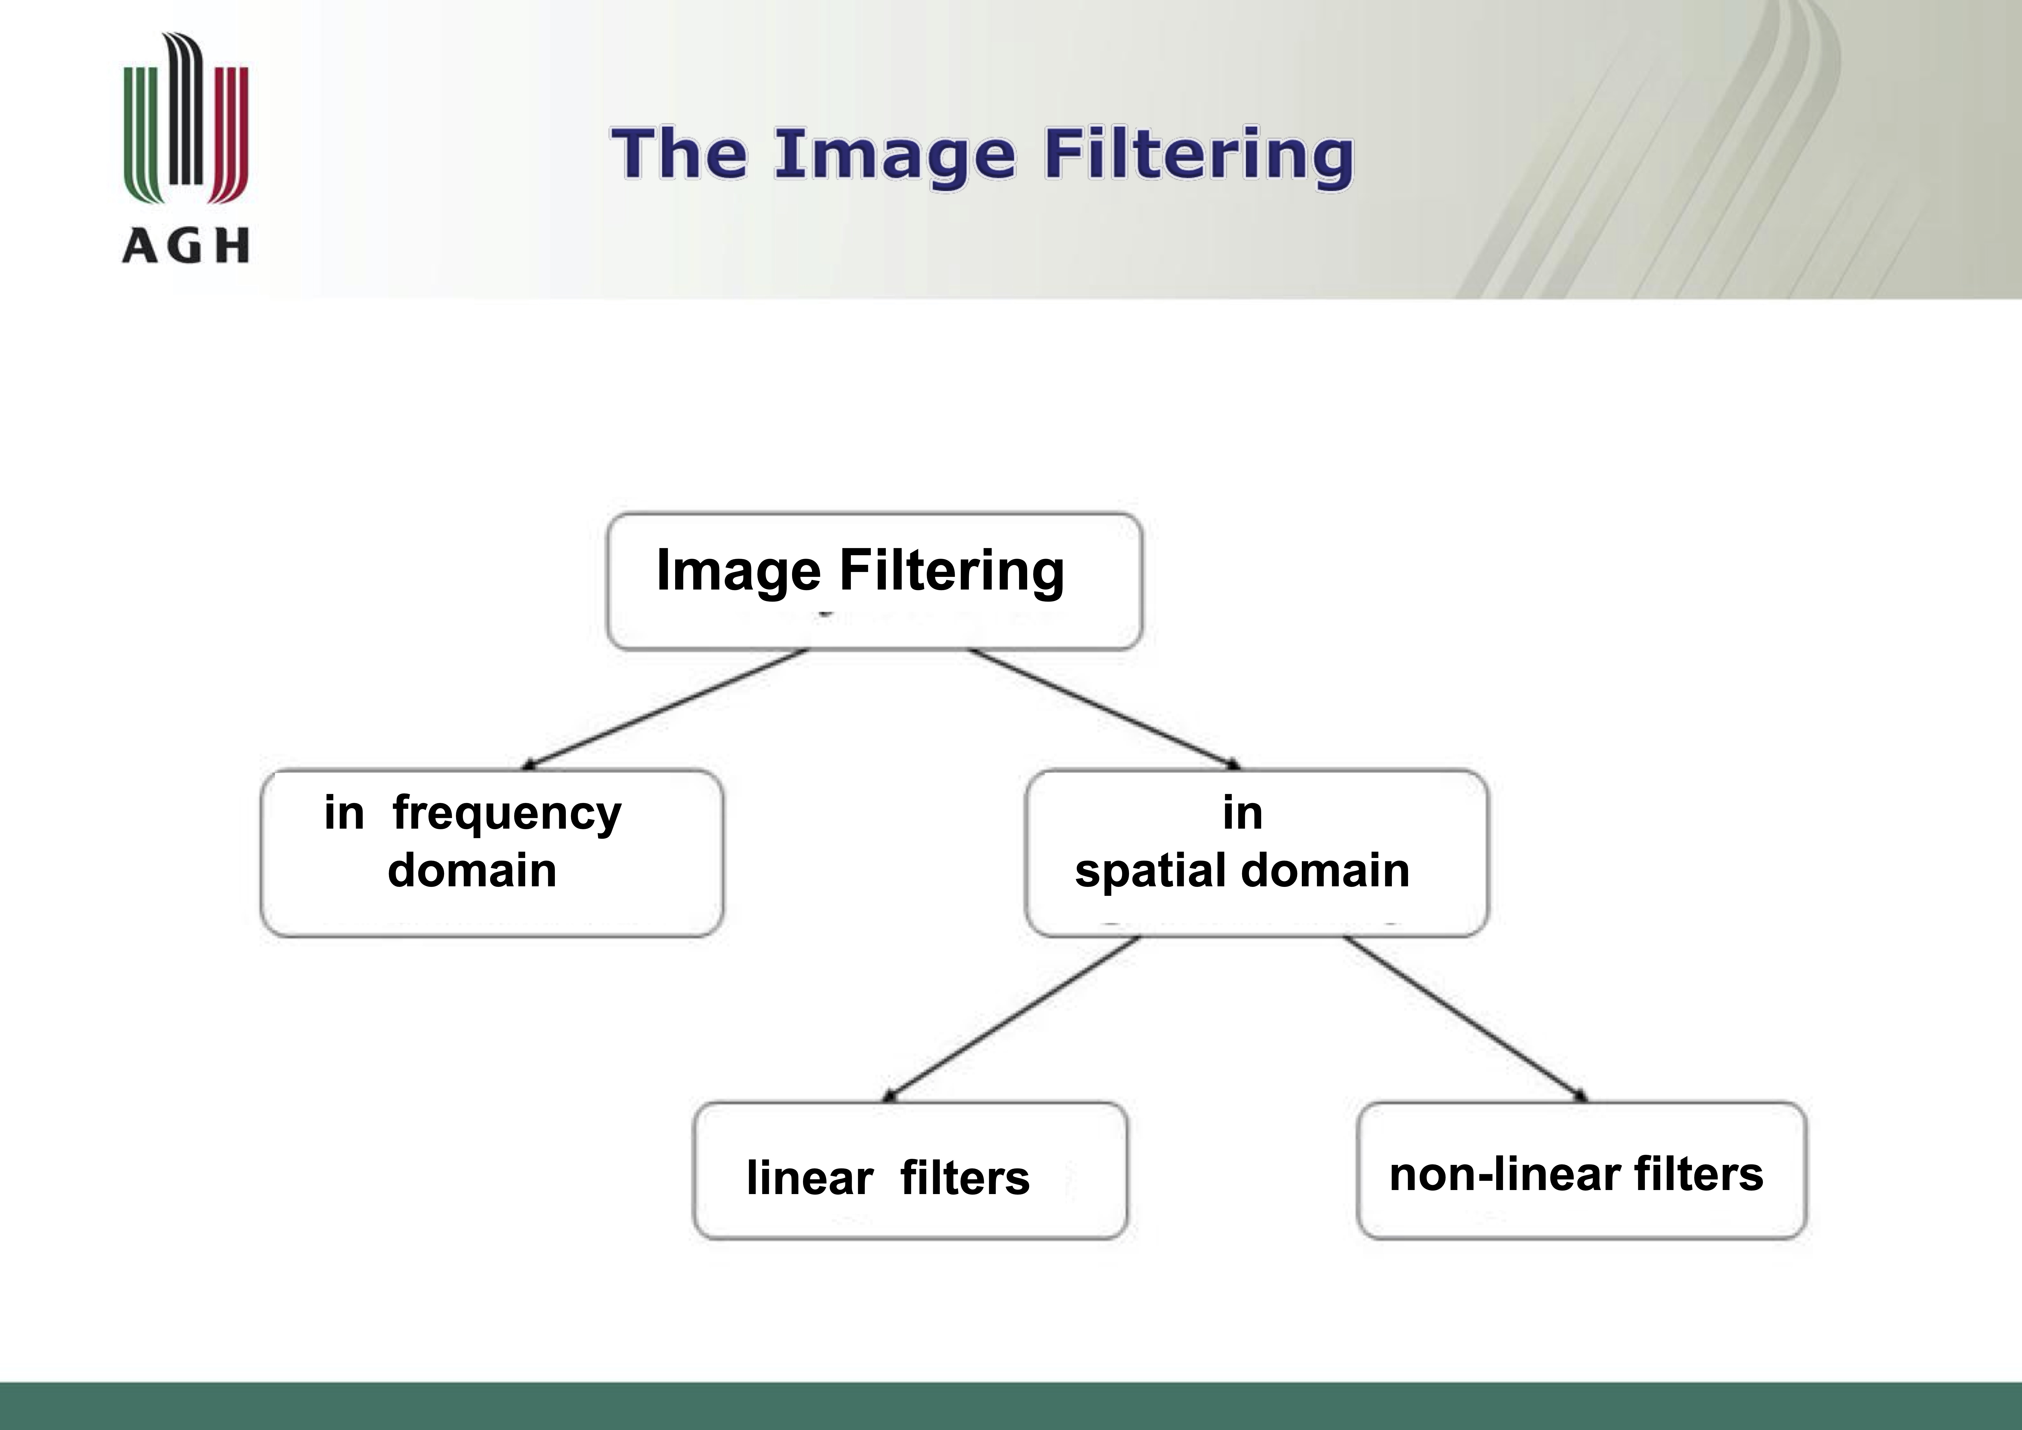

Slide 7
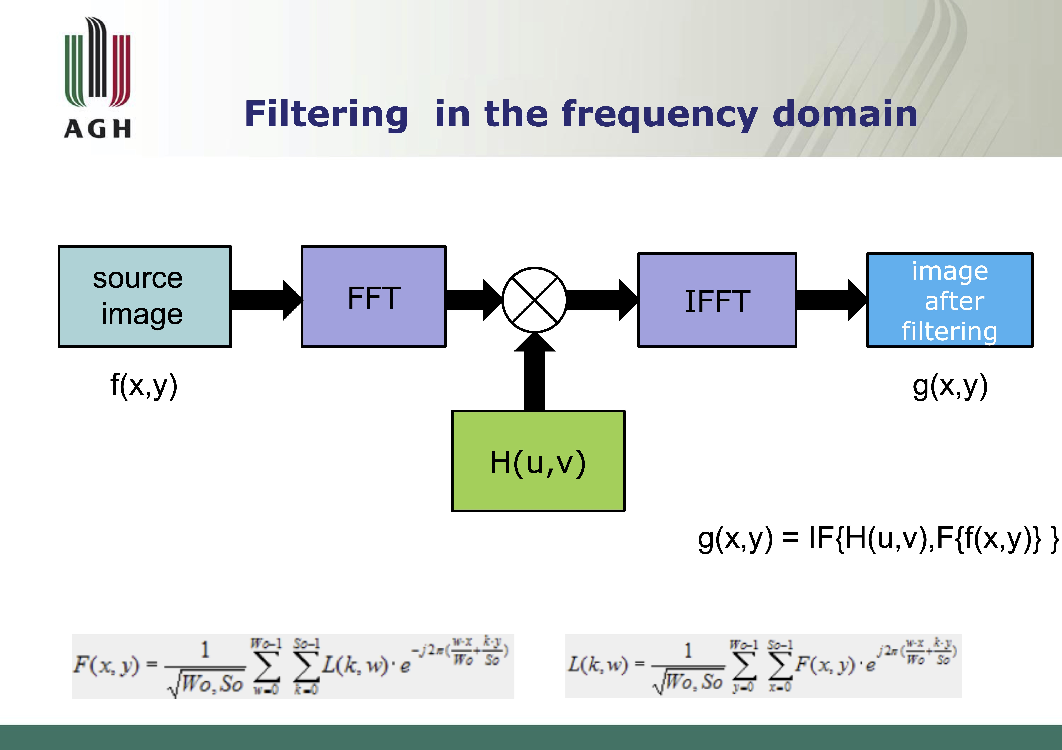

Slide 8
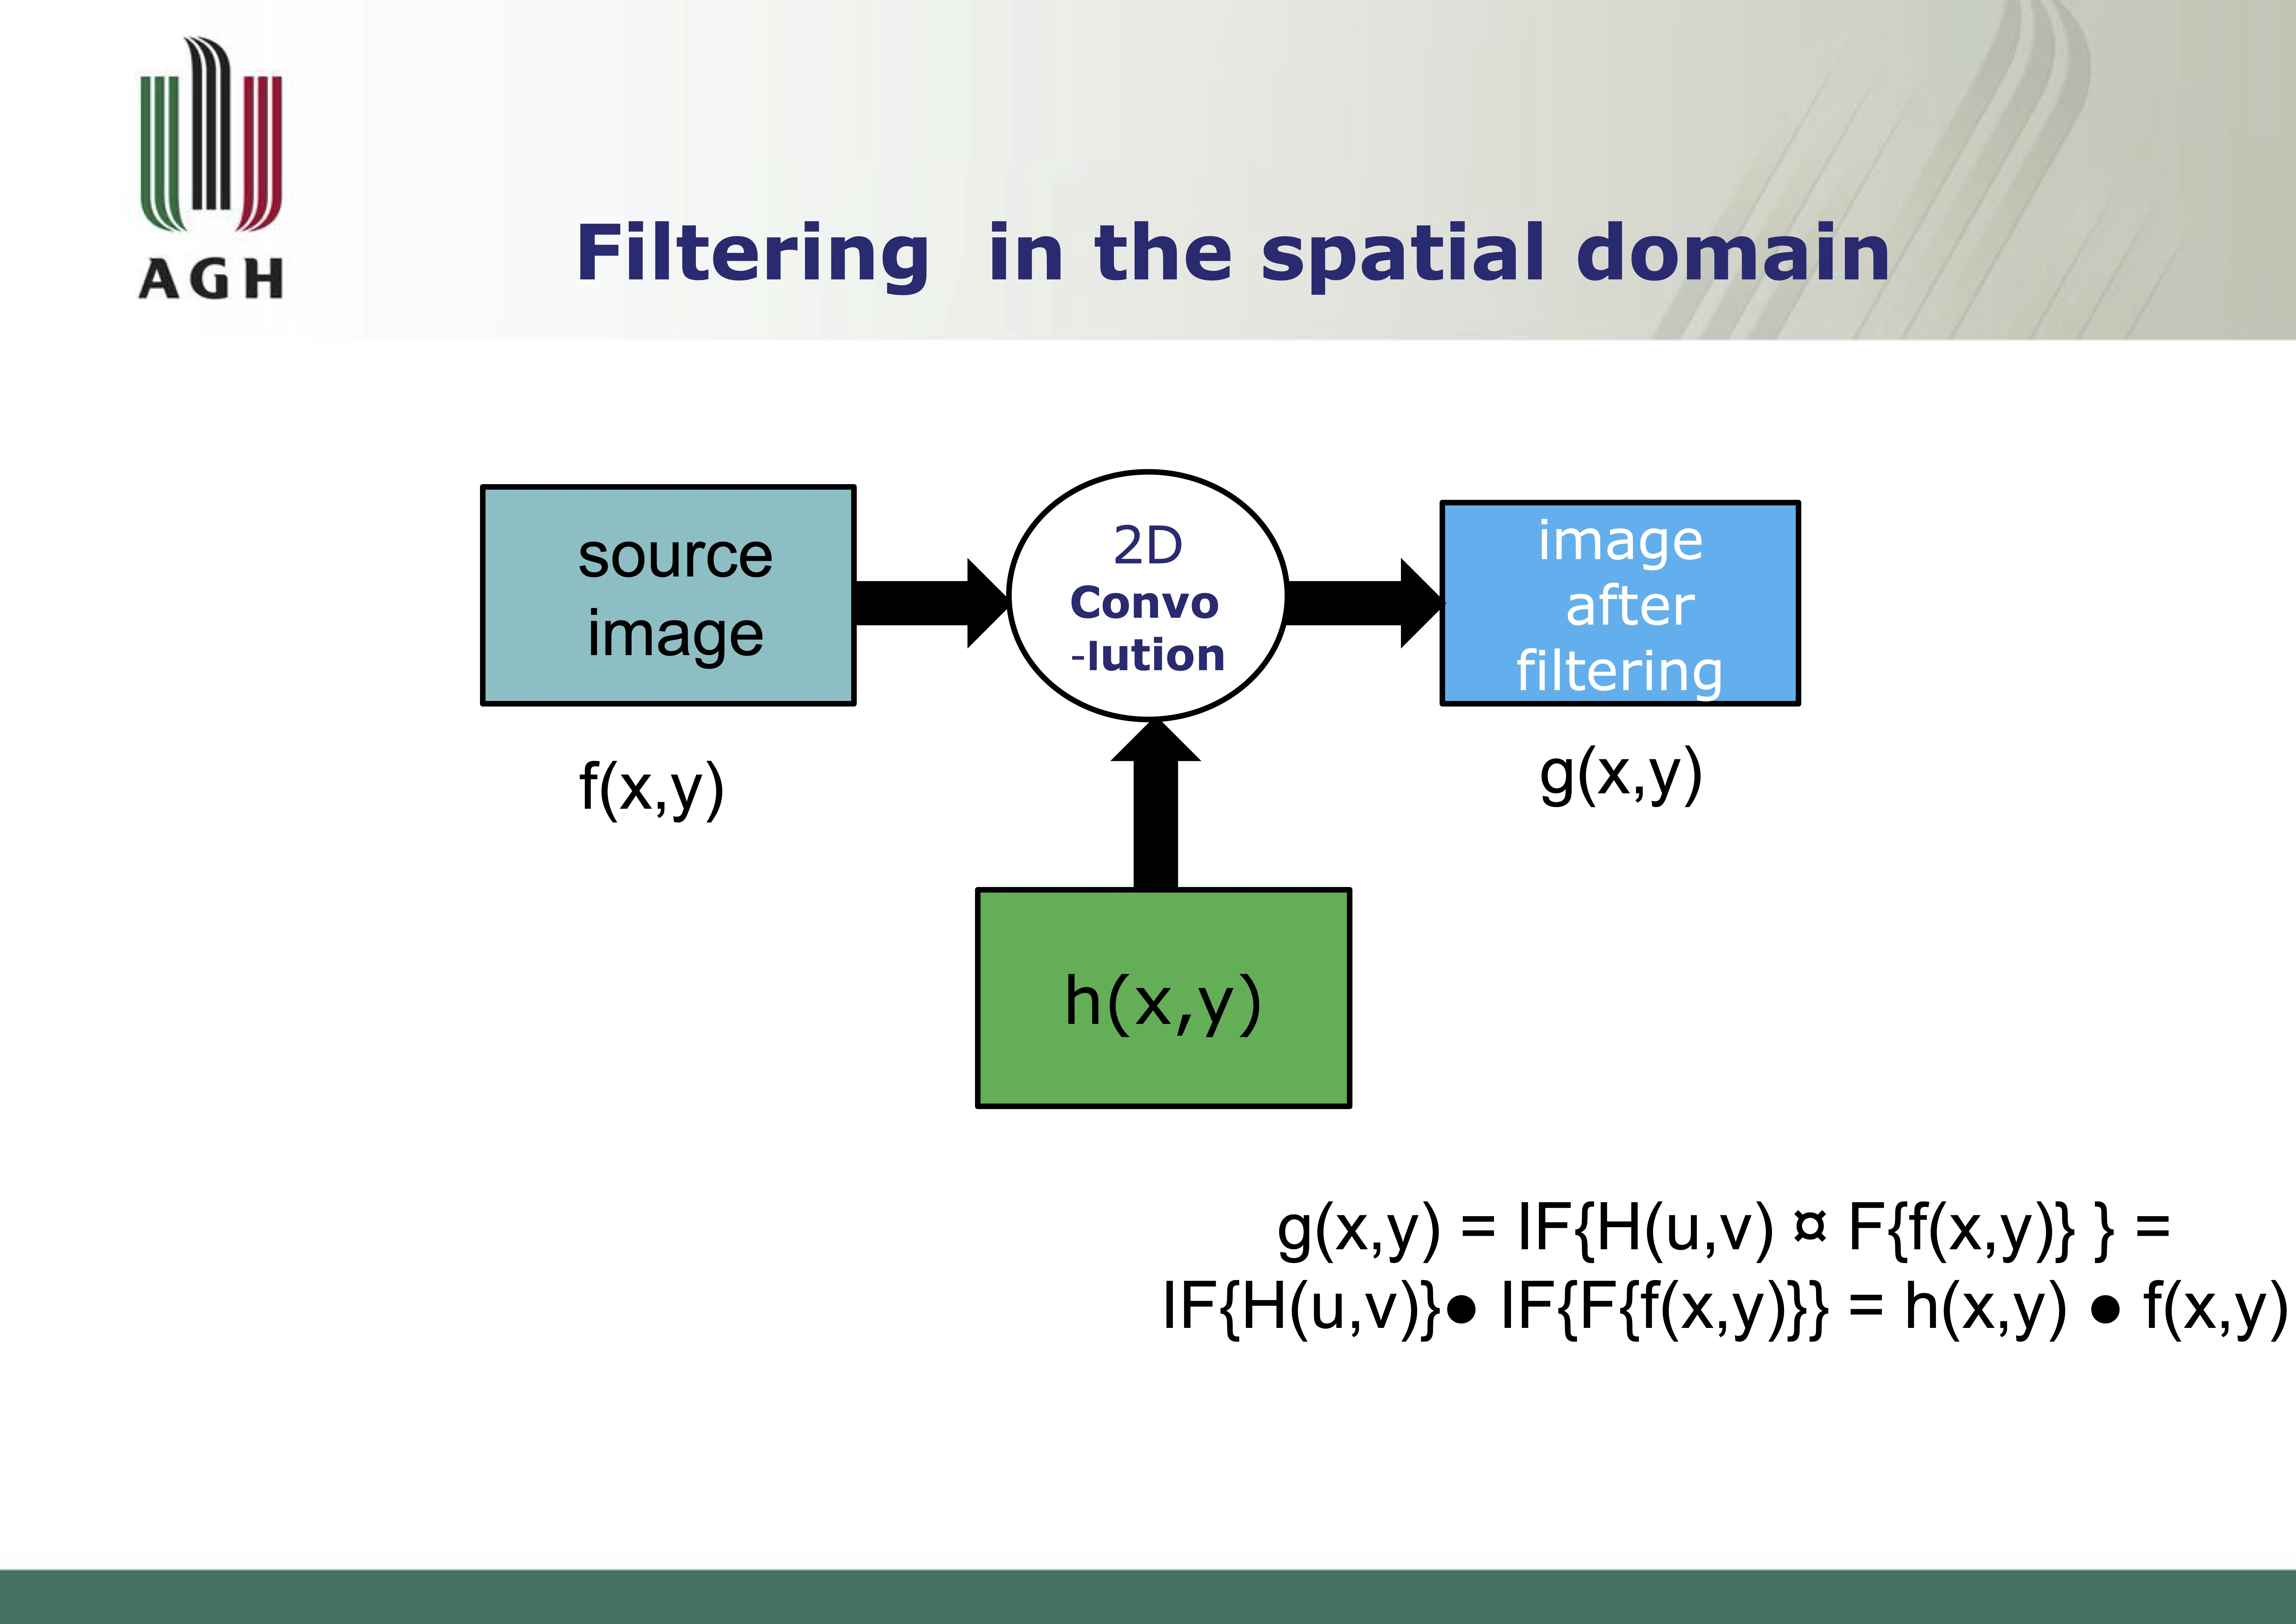

Slide 9
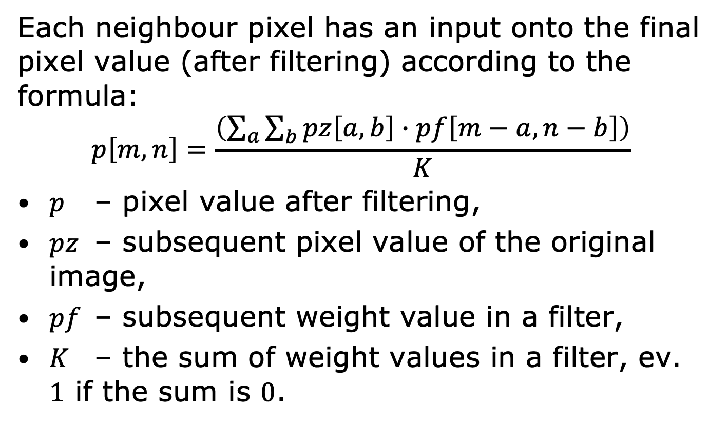
Filtering in the Spatial Domain
Each neighbour pixel has an input onto the final pixel value (after filtering) according to the formula:
$$p\left[m,n\right]=\frac{\left(\sum_{a}{\sum_{b}{pz\left[a,b\right]}∙pf\left[m−a,n−b\right]}\right)}{K}$$
$p$ – pixel value after filtering,
$pz$ – subsequent pixel value of the original image,
$pf$ – subsequent weight value in a filter,
$K$ – the sum of weight values in a filter, ev. $1$ if the sum is $0$.

Slide 10
In Practice
Notes:
We had some theory. Now, you may ask, how do I apply it in practice?
How is it done at a pixel level?
We are going to talk about a spatial filtration only - to make this discussion brief.

Slide 11
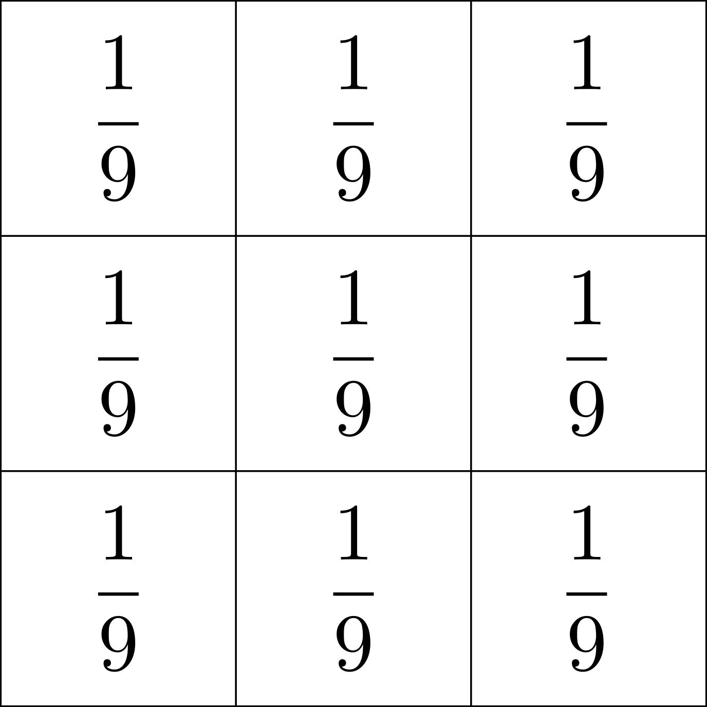

Kernel
A square matrix
Also called a mask
Its shape and contents define its operation
Has an anchor point
Also called a zero-zero index or a center point
Notes:
The kernel on the right is taken from the mean filter.
The anchor point decides in which pixel an output of the filtration will be put.
It can approximate any geometric shape. Values that do not correpond to the shape are set to 0.

Slide 12
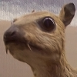
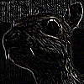
Naming Convention
Digital images filtering
Kernel filtering
Box filtering
All mean the same
Images taken from Wikimedia Commons. For an author and licensing for the upper image see here, for the second one see here.
Notes:
On the right: edge detection using a 3x3 kernel

Slide 13
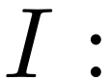
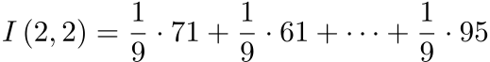
Principle of Operation
Shift and multiply
10 | 13 | 24 | 23
17 | 71 | 61 | 29
95 | 73 | 64 | 34
92 | 75 | 96 | 95
Notes:
I(2,2) - value of the pixel being in the second row and second column of the I image (0-indexing used). We are talking about the value it is to take after the filtration.

Slide 14
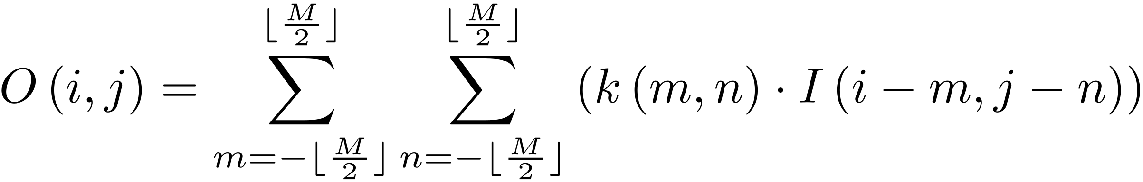
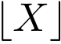
Principle of Operation
A general formula
For a kernel of size MxM pixels
O - output image, I - input image, k - kernel
I(i, j) - pixel at the i-th row and j-th column
- a floor function (round down to the nearest integer)
Notes:
A mathematical formulation of the operation shown in the previous slide.
LaTeX formula: O\left( i,j \right) = \sum^{ \lfloor{ \frac{M}{2} } \rfloor }_{m=- \lfloor{ \frac{M}{2} } \rfloor } \sum ^{\lfloor{ \frac{M}{2} } \rfloor}_{n=- \lfloor{\frac{M}{2} } \rfloor} \left( k \left( m,n \right) \cdot I\left( i-m, j-n\right) \right)

Slide 15
Edge Handling
Several strategies possible
Crop
Extend
Mirror
Wrap
? | ? | ?
? | 10 | 13 | 24 | 23
? | 17 | 71 | 61 | 29
 | 95 | 73 | 64 | 34
 | 92 | 75 | 96 | 95
Notes:
Crop - crop all pixels from the output image that cannot be created from the full kernel
Extend - extend (by copying) values from the border pixels as far as needed to satisfy kernel’s requirements
Mirror - going 2 pixels outside an image actually brings you to a pixel being 2 pixels in the opposite direction. As if one put a mirror next to the border of an image.
Wrap - going outside an image transfers you to the opposite border. For example, if one starts from the top-left pixel, going 1 pixel to the left places one in the top-right pixel.

Slide 16
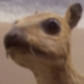
Additional Exercise
Manually perform blurring
Python 3 as a preferred language
Worth 7 points
Deadline: the end of the semester
More details in the laboratory instruction
Images taken from Wikimedia Commons. For an author and licensing for the upper image see here, for the second one see here.

